Slide 1

DEPARTMENT OF COMPUTER SCIENCE & ENGINEERING
SCHOOL OF COMPUTING
1156CS701- MAJOR PROJECT
WINTER SEMESTER 22-23
INTERNSHIP THROUGH DIND/PLACEMENT/ABRAOD
INDUSTRY/INSTITUTE NAME
REVIEW - II
“REAL-TIME AGE,GENDER PREDICTION AND CLASSIFICATION USING MACHINE LEARNING.”
SUPERVISED BY
Dr. D Rajesh
Designation:Asst.Professor
PRESENTED BY
1. SHYAM KUMAR SAH (VTU16200) (19UECS0909)
2. B.Chirumani Sai Pavan (VTU12653) (19UECS0107)

Slide 2
INDUSTRY DETAILS
Industry Name/Institute Name : MountBlue Technologies Private Limited
Duration of Internship (From Date – To Date) :
Duration of Internship in Months :
Industry Guide Name : Dr. D Rajesh
Industry Guide Mobile No :
Industry Guide Mail ID :
Industry Address : Koramangala, Bengaluru, Karnataka 560029
Project Completion Status as of now(Completed/In-Progress) :

Slide 3
AGENDA
ABSTRACT
OBJECTIVE
INTRODUCTION
LITERATURE REVIEW (SOFT COPY OF PAPERS TO BE LINKED AS HYPERLINK)
DESIGN AND METHODOLOGIES
IMPLEMENTATION
TESTING
INPUT AND OUTPUT
INCLUDE DEMO VIDEO-1 (Till REVEW-1)
INCLUDE DEMO VIDEO-2(Complete Implementation of Project)
CONCLUSION
WEB REFERENCES LINK(TILL REVIEW DATE ALL LINKS TO BE INCLUDED DAY WISE)
INCLUDE YOUR 2 PHOTOS OF YOUR INDUSTRY WORKING ENVIRONMENT
PLAGIARISM REPORT OF PPT
REFERENCES

Slide 4
ABSTRACT
Age and gender prediction are used extensively in the field of computer vision for surveillance. Convolution Neural Network (CNN) with ResNet50 architecture and the Face Landmark algorithm to predict age and gender. CNN is a Neural Network (NN) algorithm that extracts the deep features from the image and specifies the desired output at the final layers. Gender prediction is accurate in all the test data presented to the model. It can be implemented in a webpage design or an mobile application can be created where this is enhanced as the future for our project. The age estimation plays a prominent role in the applications like biometric evaluation, 3d face marking, virtual makeup, and virtual try-on applications for jewelery and eyewear by mapping the face according to the age found. Lens kart is such an application that gives the try-on option for their customers. Our model executes with approximately 85 percentage in gender prediction and 70 percentage in age prediction that can be furtherly advanced with pipelining with other classification models and much larger real-world dataset. Two approaches to this problem accurate age and age-group prediction, both using convolutional neural networks (CNNs) and deep neural networks (DNNs) - two fundamental deep learning techniques, in combination with computer vision library, OpenCV to aid in classifying input images. Work is distinguished by two main key contributions. The first is feature extraction, where convolutional activation features could be obtained through using a novel hierarchical aggregation based neural networks to learn aging features from an abundant number of training data. The second contribution is the features classification part, in which we apply the ResNet50 classifier to perform accurate age prediction whereas age-group prediction uses majority vote classifier. The results showed that the number and the quality of training images and subjects in the training dataset play a significant role in improving the accuracy of this work.
Keywords: Convolutional Neural Network, Neural Network, Deep Neural Network, Opensource Computer Vision.

Slide 5
OBJECTIVES
Aim Of The Project :-
The aim of the project is to develop a Machine Learning model that can accurately predict the age and gender of a person in real-time based on input images . The model should be able to classify individuals into different age and gender categories with high accuracy and reliability. This project has practical applications in various fields such as marketing, security, and healthcare.
Scope of the Project :-
The scope of the project is quite wide as it has a wide range of applications in various fields. Real-time age and gender prediction and classification using Machine Learning can be used in marketing to target specific age and gender demographics, in security systems to identify potential threats based on age and gender, and in healthcare to analyze patient demographics for research purposes. Additionally, this technology can be used in entertainment and social media applications to enhance user experiences. The scope of the project will also depend on the size and diversity of the dataset used to train the model, as well as the type of Machine Learning algorithm selected for the task.

Slide 6
INTRODUCTION
Age and Gender are two of the key attributes of the face, play a fundamental part in society interactions, making estimation of age and gender from a single face image a significant role in smart systems, such as access control, human computer interaction, legislation security compliance, communications and visual monitoring, etc. During the last decades,many strategies have been suggested to address the age and gender task. Earlier the usage of pixel intensity as a data feed to the classifier for its training ,Facial analysis from real time images has gained a lot of interest because it helps in several different problems like better ad targeting for customers, better content recommendation system, security surveillance, and other fields as well.Age and gender are a very important part of facial attributes and identifying them are the very basic of facial analysis and a required step for such tasks.Many companies are using these kinds of tools for different purposes making it easier for them to work with customers, cater to their needs better and create a great experience for them. It is easier to identify and predict needs of people based on their gender and age.The task of gender and age detection just from a real time image is not an easy task even for us humans because it is totally based on looks and sometimes it is not easy to guess it. People of the same age can look very different from what we can guess.And The information of age is used in many government, private and advertising sector organization to find the culprits, employee eligible for the job, audience to be targeted for their publicity of product respectively.Age and gender play fundamental roles in social interactions. Languages reserve different salutations and grammar rules for men or women, and very often different vocabularies are used when addressing elders compared to young people.The age estimation plays a prominent role in the applications like biometric evaluation, 3d face marking, virtual makeup, and virtual try-on applications for jewelry and eye-ware by mapping the face according to the age found.

Slide 7
LITERATURE REVIEW
[1] Age and Gender Estimation of Unfiltered faces was written by Eran Eidinger and Roee by using the technique Robust face alignment technique and This paper deals with the estimation of facial attributes namely, age and gender-from images of faces acquired. This problem has received far less attention than the problem of face recognition .
[2] Age Group Estimation using Face Features which was written by Ranjan Jana, Debaleen a Datta, Rituparna by using the technique K-means clustering algorithm. PCA, LDA. This paper provides a methodology to estimate the real age of a human by analyzing features of face images. Wrinkle geography areas are detected and wrinkle features are extracted from face image. Depending on wrinkle features, each face image is clustered using a fuzzy c-means clustering algorithm. Then, estimated age is calculated using their clustering membership value and average age of each cluster. The obtained results are significant and remarkable.
[3] Comparison of Recent Machine Learning Techniques for Gender Recognition from Facial Images was written by Joseph Lemley Sami Abdul-Wahid Dipayan Banik by using the technique Feature extraction techniques: PCA HOG. Gender classification methods. Recently, several machine learning methods for gender classification from frontal facial images have been proposed. Their variety suggests that there is not a unique or generic solution to this problem.
[4] Automated Estimation of Human Age, Gender and Expression which was written by Yaoyu Tao by using a technique LBP Gabor filter LDA algorithm. Age estimation by machine has been a challenging problem for a long time. Different people have different rates of aging, which is determined by not only the people’s genes but also many factors, such as health condition, living style, working environment, and sociality.

Slide 8
Cont..,
[5] Age and Gender recognition and identification from speech signals is challenging in this domain, which should be automated or smart for determining the speaker gender from voice signals was written by Parker T, Lucas pose The classification of gender and age from direct speech signals can be logically related to the time or frequency domains. In the time domain analysis, we directly measure the speech signals considering the content of a signal for evaluating information regarding a speaker,on the other hand, in the frequency domain analysis, the frequency content of a speech.
[6] Created a system for classifying gender based on energy; the signal transformation was performed using FFT, and the system secured less percentage efficiency. Several methods use machine learning techniques for classification and classify gender and age with high accuracy of 62.5 percentage.Romi R,Natalya brooke,Xev rengerbell The proposed system utilizes a windowing and pre-emphasis technique for noise cancellation during the preprocessing phase.
[7] A. Gunay and V. Vasif, “Age estimation based on AAM and 2D-DCT features of facial images,” International Journal of Advanced Computer Science and Applications, vol. 6, no. 2, pp. 113–119, 2015.
[8] M. Y. El Dib and M. El-Saban , Human Age Estimation Using Enhanced Bio- Inspired Features (EBIF), Faculty of Computers and Information, Cairo University, Cairo, Egypt, 2010.
[9] Agbo-Ajala O, Viriri S. Deeply Learned Classifiers for Age and Gender Predictions of Unfiltered Faces. ScientificWorldJournal. 2020 Apr 30; 2020:1289408. doi: 10.1155/2020/1289408. PMID: 32395084; PMCID: PMC7201854.

Slide 9
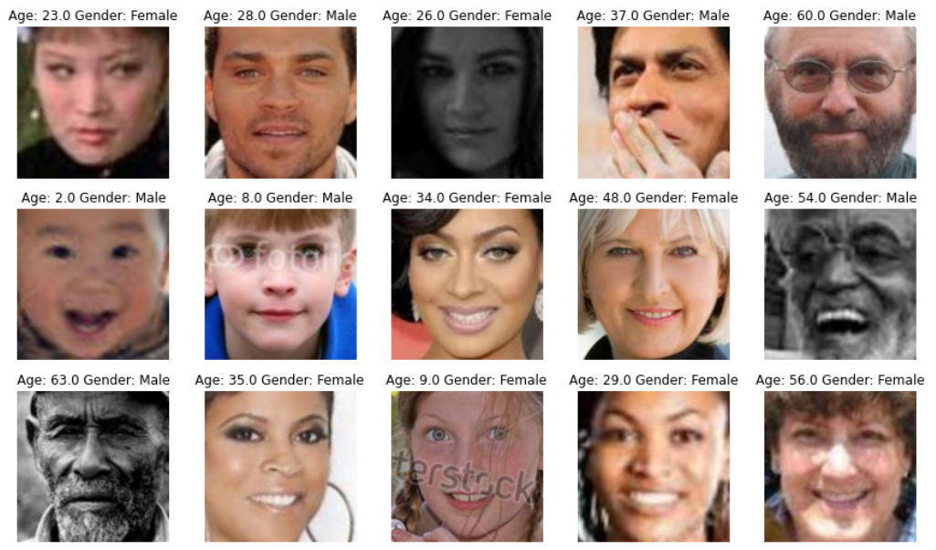
DESIGN AND METHODOLOGIES
MODULE 1:-
Data Collection and Preprocessing :
The collected data(i.e. Image or Video) is preprocessed to remove any noise and standardize the size of In this module, data is collected in the form of images or videos containing faces. The images or videos are collected from various sources and are labeled with the corresponding age and gender of the person in the images. This is done to ensure that the images are consistent and suitable for training the machine learning model.

Slide 10
Cont..
MODULE 2:-
Feature Extraction :-
In this step, we use pre-trained convolutional neural networks (CNNs) i.e. ResNet or VGG to extract high-level features from images. These features are used to represent the visual information in images in a way that can be used for prediction.
MODULE 3:-
Model Training and Evaluation :-
We used HDF5 dataset that has more than 1000 pictures of male and female actors age from 0 to 100 , we used a Convolution Neural Network (CNN) with ResNet50 architecture to predict age and gender. We evaluate the performance of our model on the validation set and fine-tune the hyperparameters to improve the performance.

Slide 11

Cont..

Slide 12
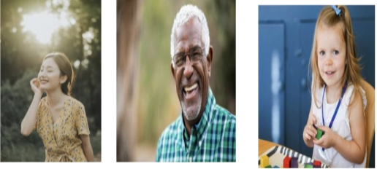
Cont..,
MODULE 4 :-
Real-time Prediction and Deployment :-
In this step, we use the trained model to predict the age and gender of new images in real-time. We can use a webcam or other image sources to capture new images, and the model can be deployed on a cloud server or embedded in a device to provide real-time predictions.

Slide 13


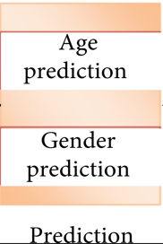
IMPLEMENTATION
ARCHITECTURE DIAGRAM
Preprocessing
Feature Extraction
Classification
Feature Selection
Recommender System
Output

Slide 14
DATA FLOW DIAGRAM
Image/Video Data
Data Preprocessing
Feature Extraction
User Interface
Predicted Age/Gender
Machine Learning & Model Training

Slide 15
ER DIAGRAM
Facial Feature
Age
Face Region
Recognizer
Name
Gender
Facial Matrix
Person
Pre-Processor
Facial Landmark Check
Image
Face Detection
Age and Gender Detected
Face Tagging

Slide 16
SEQUENCE DIAGRAM
User
Algorithm
Trained Model
Classification
Input Image From Camera
Data Preprocessing
Dataset Training
Data Cleaning
Localization
Output
<----------------------------------------------------------------------

Slide 17
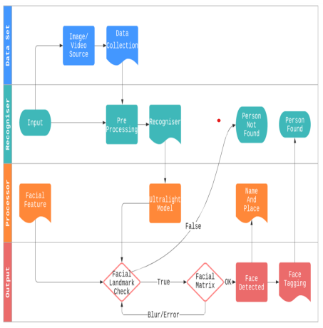
COLLABORATION DIAGRAM

Slide 18
TESTING
TESTING UNIT :-
This project features a very vast scope in future. this will be implemented on intranet in future. Project are often updated in near future and when requirement for an equivalent arises, because it is extremely flexible in terms of the expansion .
INTEGRATION TESTING :-
Integration testing may be a level of software testing where the individual units are combined and tested as group. The purpose of this level of testing is to show faults within the interaction between the integrated units.
FUNCTIONAL TESTING :-
It is a sort of software program checking out wherein the device is examined in opposition to the useful necessities/specifications. Functions are examined by feeding them entering and analyzing the output. Functional checking out guarantees that the necessities are nicely glad through the application. So, it attempts to execute the check instances and examine the outcomes and test the accuracy.
WHITE BOX TESTING:-
White box testing is a type of testing that examines the internal workings of a software system. The purpose of white box testing is to validate the correctness of the code, test the software's internal logic, and ensure that the software functions correctly.
BLACK BOX TESTING:-
Black box testing is a type of testing that examines the external behavior of a software system. The purpose of black box testing is to ensure that the software system behaves correctly, without looking at the internal workings of the system.

Slide 19
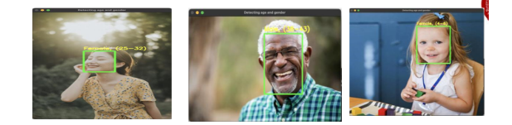
INPUT AND OUTPUT
SCREENSHOTS

Slide 20
CONCLUSION
Finally, The human age and gender prediction have already achieved high levels of accuracy, opening the path for practical applications. However, there is no denying that the current system has some disadvantages, the most notable of which is slow operation and inefficiency. Due to the crucial necessity to develop an intelligent monitoring system to detect and identify human faces, we provided a quick and robust approach that can instantaneously detect and identify human faces. The proposed approach not only exceeds previous work in terms of speed, but also in terms of accuracy, outperforming the current state-of-the-art human detection system. The user’s physical engagement has no effect on it. It has extremely exact readings and can be deployed and verified quickly. Different people have different human faces based on a variety of factors. The uniqueness and measurement of the many parameters assist us in recognizing the individuals. In conclusion, state-of-the-art approaches for age and gender have already demonstrated a high rate of accuracy, resulting in practical applications. However, it cannot be denied that employing the existing method has a number of drawbacks, the most notable of which are slow performance and inefficiency. We provided a fast and robust approach that can immediately detect and identify human faces due to the critical need of establishing an intelligent surveillance system to detect and identify human faces. The suggested approach not only outperforms earlier work in terms of speed, but also in terms of accuracy when compared to a state-of-the-art human detection system. Age and gender prediction systems based on our proposed model are advantageous to the globe ,the age estimation plays a prominent role in the applications like biometric evaluation, 3d face marking, virtual makeup, and virtual try-on applications for jewelry and eye-ware by mapping the face according to the age found.

Slide 21
Web references/video links
https://www.geeksforgeeks.org/age-detection-using-deep-learning-in-opencv/
https://towardsdatascience.com/real-time-age-gender-and-emotion-prediction-from-webcam-with-keras-and-opencv-bde6220d60a
https://erandiganepola.medium.com/machine-learning-based-age-and-gender-predictions-in-image-processing-223031dea847
https://www.hindawi.com/journals/cmmm/2022/1413597/
https://www.youtube.com/watch?v=rdjWDAYt98s
https://www.youtube.com/watch?v=JmvmUWIP2v8

Slide 22
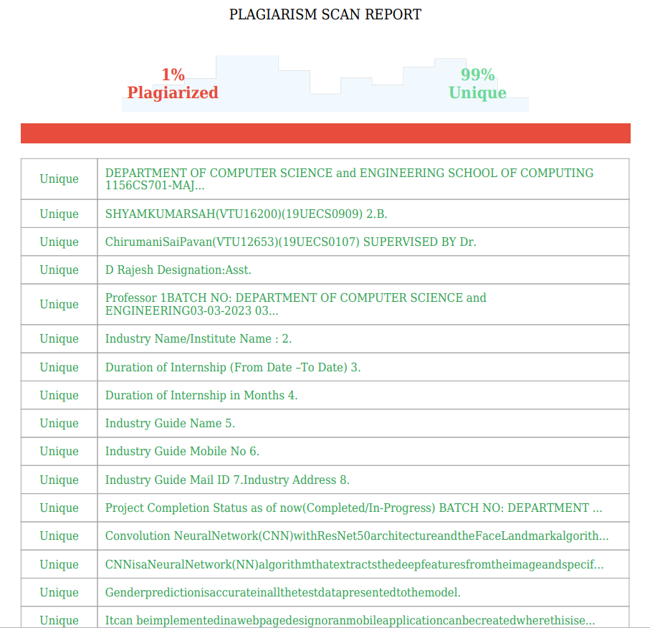
Plagiarism Report of PPT
Include Plagiarism report of PPT

Slide 23
REFERENCES(as per IEEE format only)
[1] Jinbao Wang; Shujie Tan; Xiantong Zhen; Shuo Xu; Feng Zheng; Zhenyu He; Lin Shao, “Deep 3D human pose estimation: A review,” Computer Vision and Image Understanding, Volume 210, September 2021.
[2] Eran Edinger and Roee, “Age and Gender Estimation of Unfiltered Faces,” IEEE TRANSACTION, DEC. 2020.
[3] Héctor A. Sánchez- Hevia , Roberto Gil-Pita, Manuel Utrilla-Manso, Manuel Rosa- Zurera , “Convolutional-recurrent Neural Network for Age and Gender Prediction from Speech” in proceedings of 2019 Signal Processing Symposium (SPSympo). pages 242-245.
[4] Kyoungson Jhang, Junsoo Cho, “CNN Training for Face Photo based Gender and Age Group Prediction with Camera” in proceedings of 2019 International Conference on Artificial Intelligence in Information and Communication (ICAIIC), pages 548-551.
[5] Koichi Ito, Hiroya Kawai, Takehisa Okano and Takafumi Aoki, “Age and Gender Prediction from Face Images Using Convolutional Neural Network” in Proceedings of APSIPA Annual Summit and Conference 2018.
[6] Kundan Nigam, Sahil Sharma, Prashant Singh Rana, “Gender, Makeup, Age and Illumination Prediction from Faces using Ensemble Modelling,” 2018 3rd International Conference for Convergence in Technology (I2CT). The Gateway Hotel, XION Complex, Wakad Road, Pune, India. Apr 06-08, 2018. Pages 1-6.
[7] Yaoyu Tao “Automated Estimation of Human Age, Gender and Expression ,” Stanford, CA 94305, USA,May 2020, vol. 4, pp. 43-57.
[8] P. Smith and C. Chen, ``Transfer learning with deep CNNs for gender recognition and age estimation,'' in Proc. IEEE Int. Conf. Big Data (Big Data),Dec. 2018, pp. 2564-2571.
[9] Marcin Kopaczka;Jan Nestler;Kevin Kielholz; “A combined modular system for face detection,face tracking and emotion recognition in thermal infrared images”,IEEE International Conference on Imaging Systems and Techniques(IST), 2018.

